Slide 1
Project 1:
Food Desert Analysis
By:
Amanpreet Kaur
Sharon Romero
Nathan Transon
Mary Gerges

Slide 2
What is a Food Desert?
USDA defines living in a food desert as:
Living more than one mile from a supermarket in urban/suburban areas, and
More than 10 miles from a supermarket in rural areas.

Slide 3
Cities/Counties included in our analysis
Napa, CA - Napa County
Rural/Urban
Bronx, NY - Bronx County
Suburban/Urban
San Francisco (Bay Area) - San Francisco County
Urban/Rural
Victorville, CA - San Bernardino County
Urban/Rural
an

Slide 4
Questions we want to answer
Has there been improvement at our 4 locations on availability of supermarkets?
Is there a correlation between poverty rate vs food deserts?
Is there a correlation between population and food deserts?
Is there a correlation between urban/non-urban areas and food deserts?
Has there been improvement on availability of supermarkets in the US overall?
(Motivation to answer these questions)

Slide 5
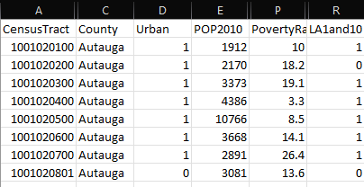
CSV Analysis
Food Access Research Atlas
CensusTract
County
LA1and10
POP2010
Urban
PovertyRate

Slide 6
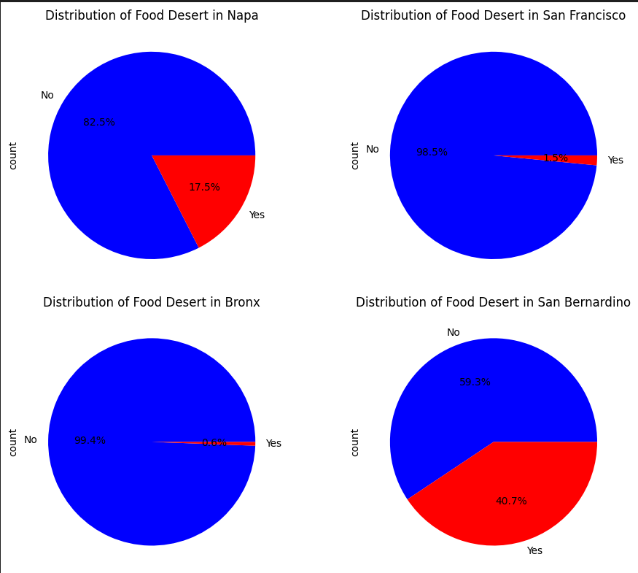
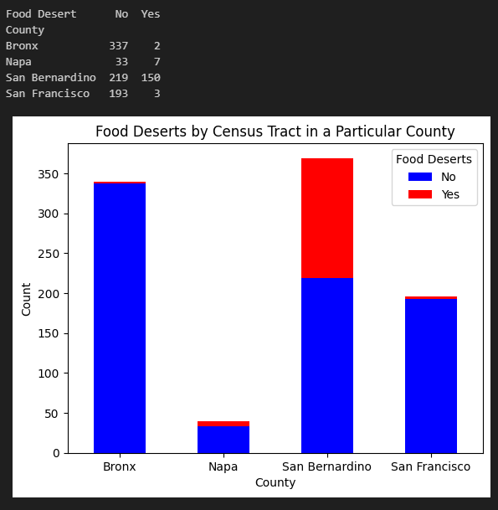
Census Tract Count
Bronx
Napa
San Bernardino
San Francisco

Slide 7
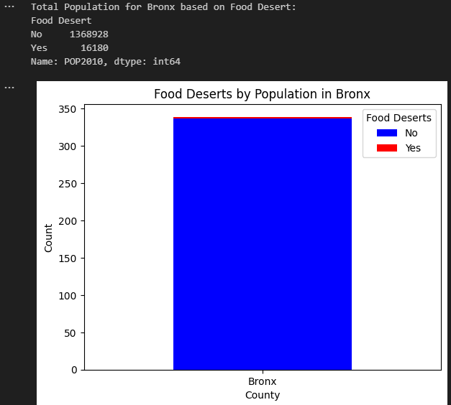
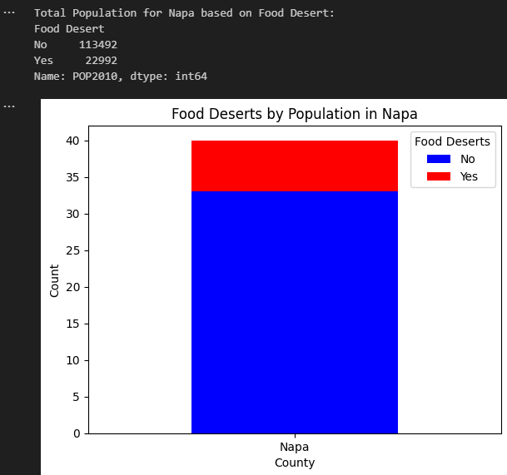
Population Count

Slide 8
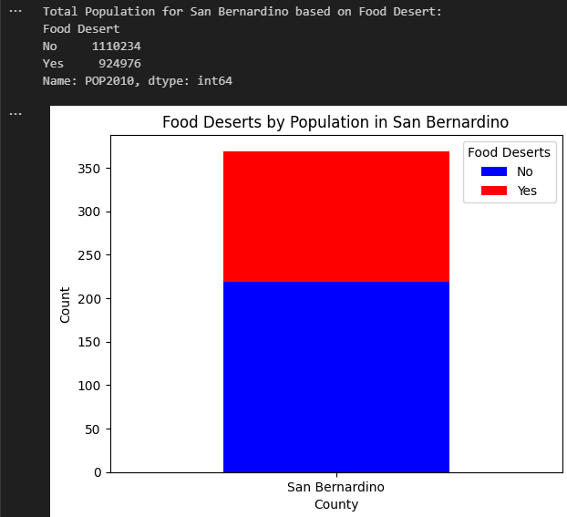
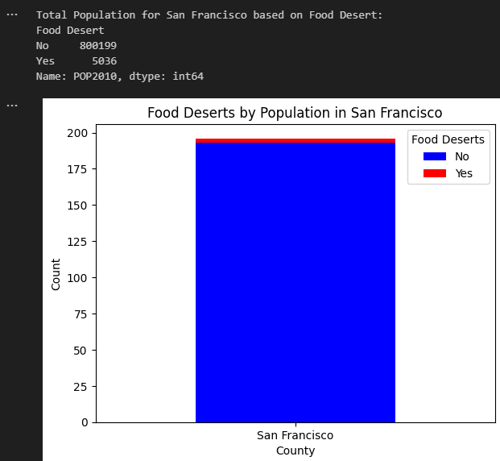
Population Count (con’t)

Slide 9
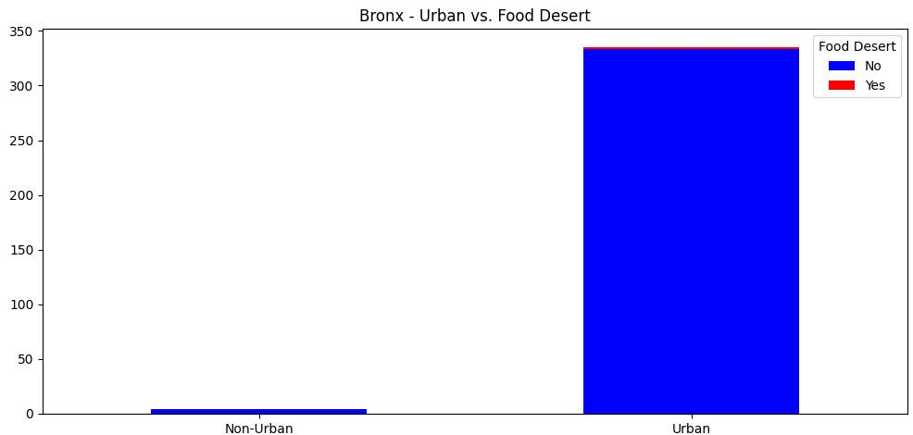
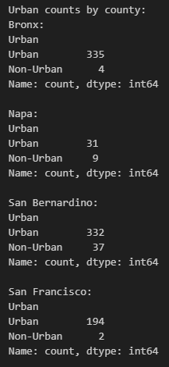
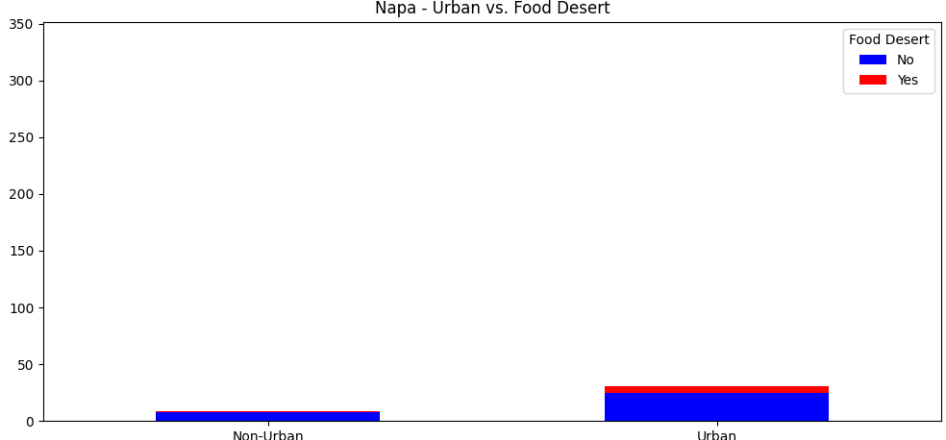
Urban vs. Non-Urban

Slide 10
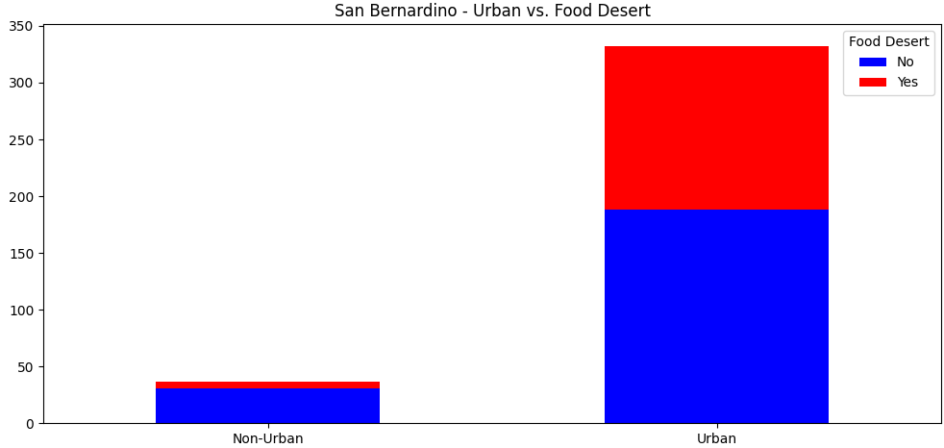
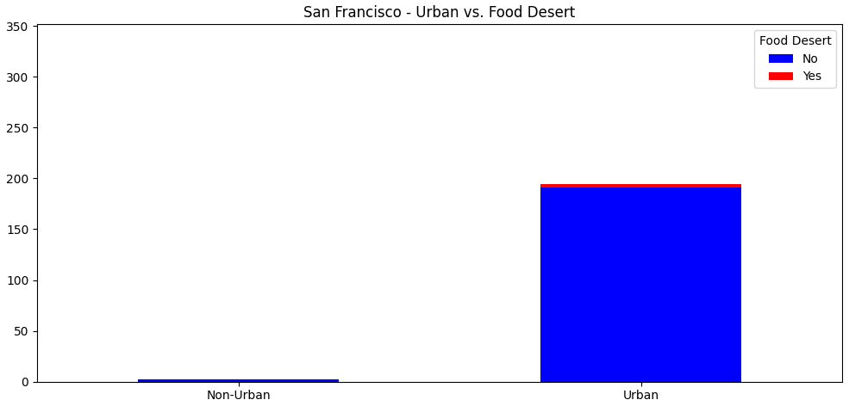
Urban vs. Non-Urban (Cont.)
San Bernardino again the outlier

Slide 11
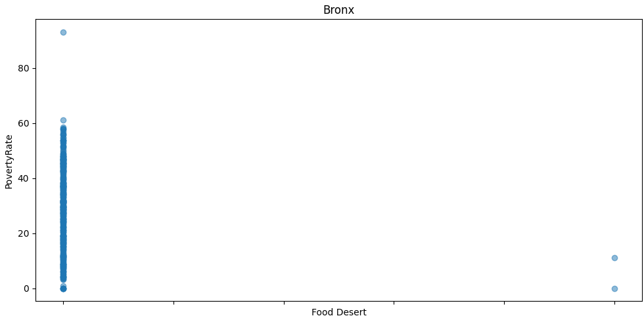
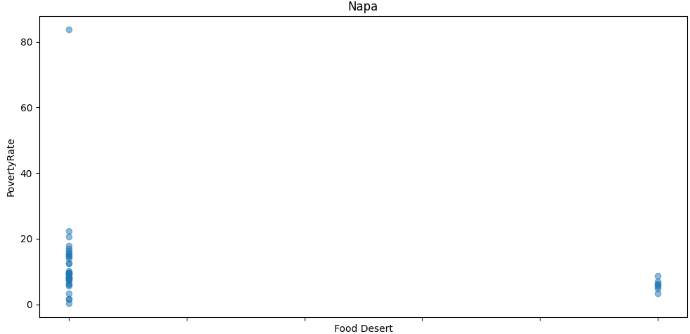
Poverty Rate
Not the most ideal visualization, but it still visualizes the data.

Slide 12
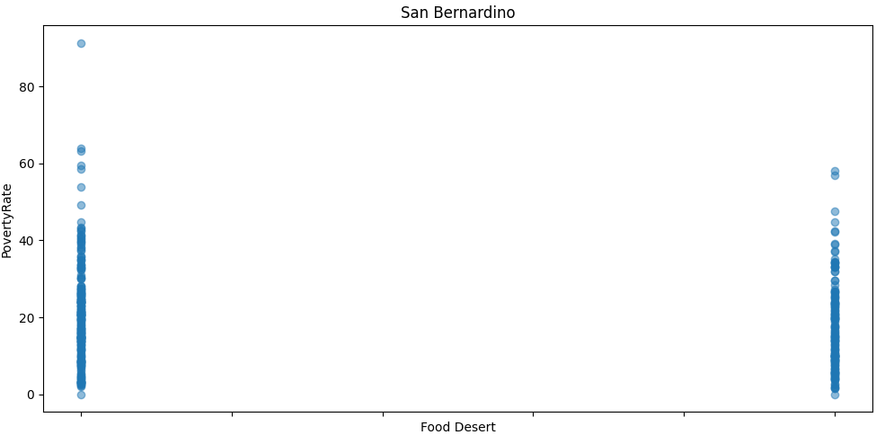
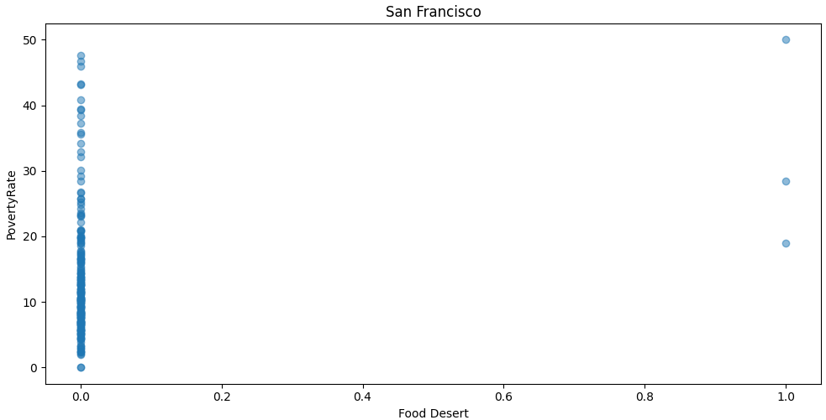
Poverty Rate (cont.)

Slide 13
API Data
Notes:
Analysis Process for jupyter lab: explain the code

Slide 14
Answers to the questions
(Where and how we found the data to answer them)
Has there been improvement at our 4 locations on availability of supermarkets?
Is there a correlation between poverty rate vs food deserts?
Is there a correlation between population and food deserts?
Is there a correlation between urban/non-urban areas and food deserts?
Has there been improvement on availability of supermarkets in the US overall?

Slide 15
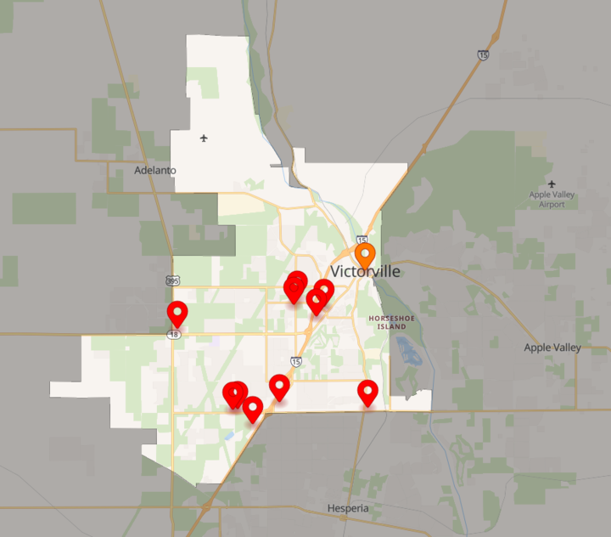
Data Challenges
> County vs City vs Census Tracts
Common basis for comparison?
Repeatable through different sources, for different time periods?
> Study did not provide source data for the classification of food desert Y/N
> Is there a better chart for plotting boolean values?
Batching calls to an API

Slide 16
Conclusions/Implications
(What do our findings mean?)

Slide 17
References
Datasets:
https://www.kaggle.com/code/kerneler/starter-food-deserts-in-the-u-s-3f49ae84-7/input
Definitions: https://www.kaggle.com/datasets/tcrammond/food-access-and-food-deserts
https://www.ers.usda.gov/data-products/food-access-research-atlas/documentation/

